Slide 1


Database Decomposition & Polyglot Persistence
By Evan Kutera
Notes:
Hello everyone. Today, I'll be presenting on Database Decomposition and Polyglot Persistence.
These are two approaches used in database management and software development to help organize information and support different application needs.
I'll explain what each approach means, how they work, and why they're important when developing software. I'll also go over some examples to show how these concepts can be used in real applications.

Slide 2
Why Database Design Matters
Databases play an important role in modern software applications by storing, organizing, and retrieving information.
Poor database design can lead to duplicate data, inconsistent records, slower queries, and maintenance problems.
As applications grow, developers need strategies to manage increasingly complex data.
Database decomposition and polyglot persistence are two approaches that help address these challenges.
Both approaches support the development of scalable, reliable, and maintainable software systems.
Notes:
Before getting into the main topics, I want to explain why database design matters.
Most software applications depend on databases to store and retrieve information. For example, online stores need to manage customers, products, and orders.
If a database isn't designed properly, it can lead to duplicate records, inconsistent information, and difficulties maintaining the application.
As an application grows, these problems can become more noticeable.
Database decomposition and polyglot persistence are two ways developers can address different database design challenges.

Slide 3

What Is Database Decomposition?
Database decomposition is the process of dividing a large relational database table into smaller, related tables.
It is commonly performed during database normalization to improve data organization and reduce redundancy.
Relationships between the resulting tables are maintained through primary keys and foreign keys.
A good decomposition should be lossless, meaning the original information can be reconstructed by joining the tables.
The goal is to improve data integrity without losing important relationships.
Notes:
Database decomposition means taking a large relational table and dividing it into smaller tables that are connected to each other.
The purpose is to organize information better and reduce unnecessary duplication.
For example, instead of keeping customer names, email addresses, and orders in one table, we can separate customer information into a Customers table and order information into an Orders table.
The tables can still communicate through primary keys and foreign keys.
One important goal is making sure we don't lose information when we separate the tables.

Slide 4
Why Do We Use Database Decomposition?
Reduce Redundancy: Prevent repeated information from being stored unnecessarily.
Improve Data Integrity: Help keep records accurate and consistent.
Prevent Update Anomalies: Reduce problems when inserting, updating, or deleting records.
Simplify Maintenance: Make it easier to manage individual tables and relationships.
Support Normalization: Organize relational data according to database design principles such as First, Second, and Third Normal Form.
Notes:
There are several reasons why database decomposition is useful.
One major reason is reducing redundancy, which means we don't need to store the same information repeatedly.
Another reason is improving data integrity. If a customer changes their email address, we should only need to update it in one location instead of changing multiple records.
Decomposition also helps prevent problems when inserting, updating, or deleting information.
Overall, it makes the database easier to organize and maintain.

Slide 5
Understanding Database Normalization
Database normalization is the process of organizing relational data to reduce redundancy and improve data integrity.
First Normal Form (1NF): Requires each field to contain a single value and each record to be uniquely identifiable.
Second Normal Form (2NF): Requires 1NF and removes partial dependencies on a composite primary key.
Third Normal Form (3NF): Requires 2NF and removes transitive dependencies of non-key attributes on a candidate key.
Normalization often involves decomposing large tables into smaller, related tables.
Proper normalization helps prevent insertion, update, and deletion anomalies.
Notes:
Database normalization is closely related to decomposition.
Normalization provides rules that help developers determine how relational tables should be organized.
First Normal Form focuses on storing individual values in fields and identifying records.
Second Normal Form builds on that and addresses partial dependencies involving composite keys.
Third Normal Form helps remove transitive dependencies so information depends on the appropriate keys.
The main thing to understand is that normalization helps prevent duplicated information and data inconsistencies.
We use decomposition to separate tables when normalization shows that the original design can be improved.

Slide 6

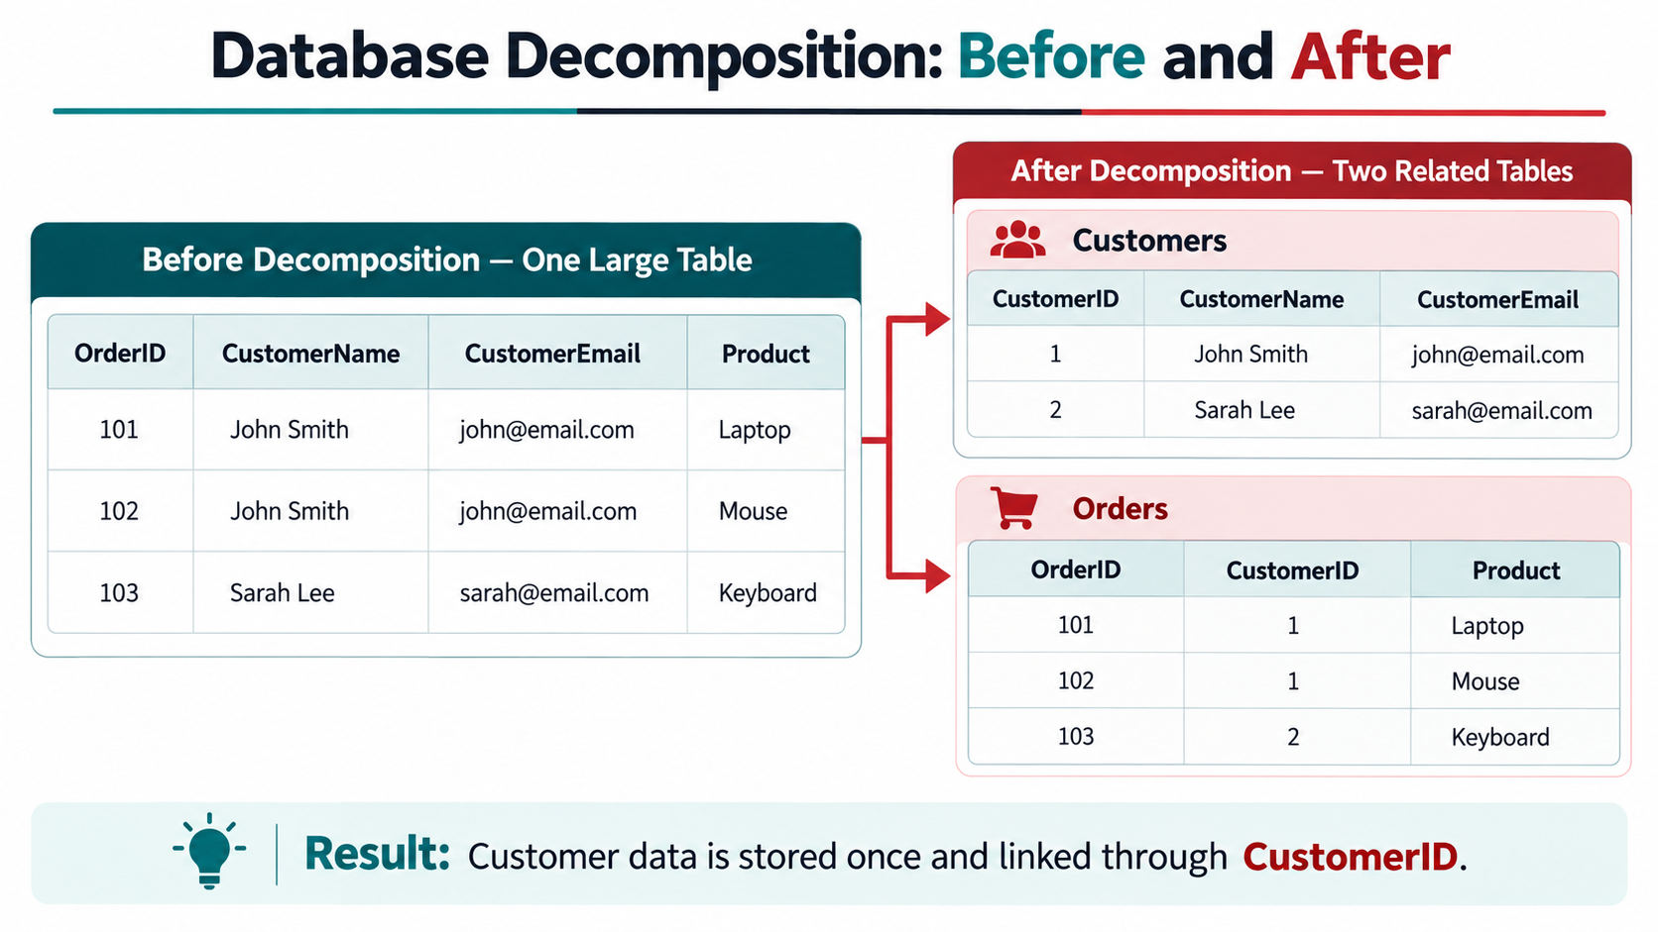



Database Decomposition Example
Notes:
This slide gives a practical example of database decomposition.
Before decomposition, customer information and order information are stored together in one large table.
Notice that John Smith's name and email appear multiple times because he placed more than one order.
That means if his email changes, we might have to update several rows.
After decomposition, we create two tables: Customers and Orders.
The Customers table stores each customer's information once. The Orders table contains the order details and uses CustomerID to identify which customer placed each order.
This allows us to reduce duplicated information without losing the relationship between customers and orders.

Slide 7
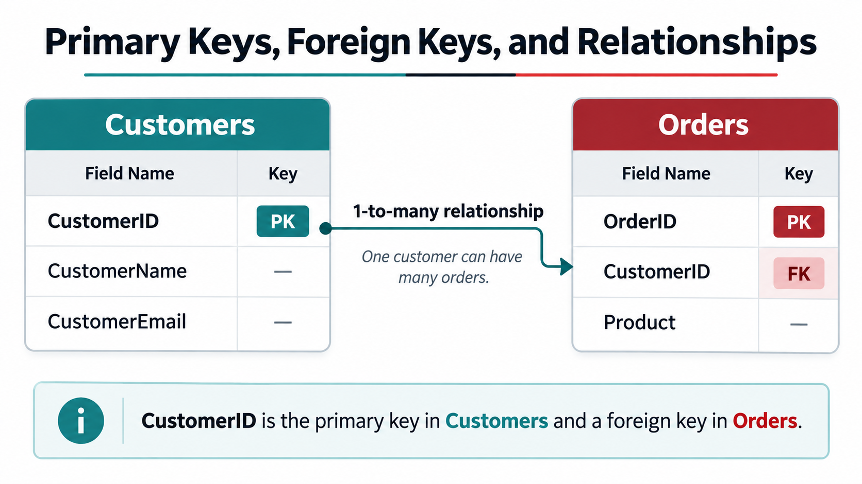
Primary Keys, Foreign Keys, and Relationships
Primary Key: A column or combination of columns that uniquely identifies each record in a table.
Foreign Key: A column or combination of columns that references a key in another table.
One-to-Many Relationship: One customer can be associated with multiple orders.
Referential Integrity: Ensures that foreign key values reference valid records.
Primary and foreign keys help maintain connections between tables after database decomposition.
These relationships allow developers to retrieve information across multiple tables using SQL JOIN operations.
Notes:
When we separate tables, we need a way to connect them.
That's where primary keys and foreign keys come in.
A primary key uniquely identifies a record. For example, each customer has a CustomerID.
A foreign key references a key in another table. In our Orders table, CustomerID identifies the customer associated with an order.
This creates a one-to-many relationship because one customer can place multiple orders.
These relationships are important because they allow us to organize information into separate tables while keeping the data connected.

Slide 8
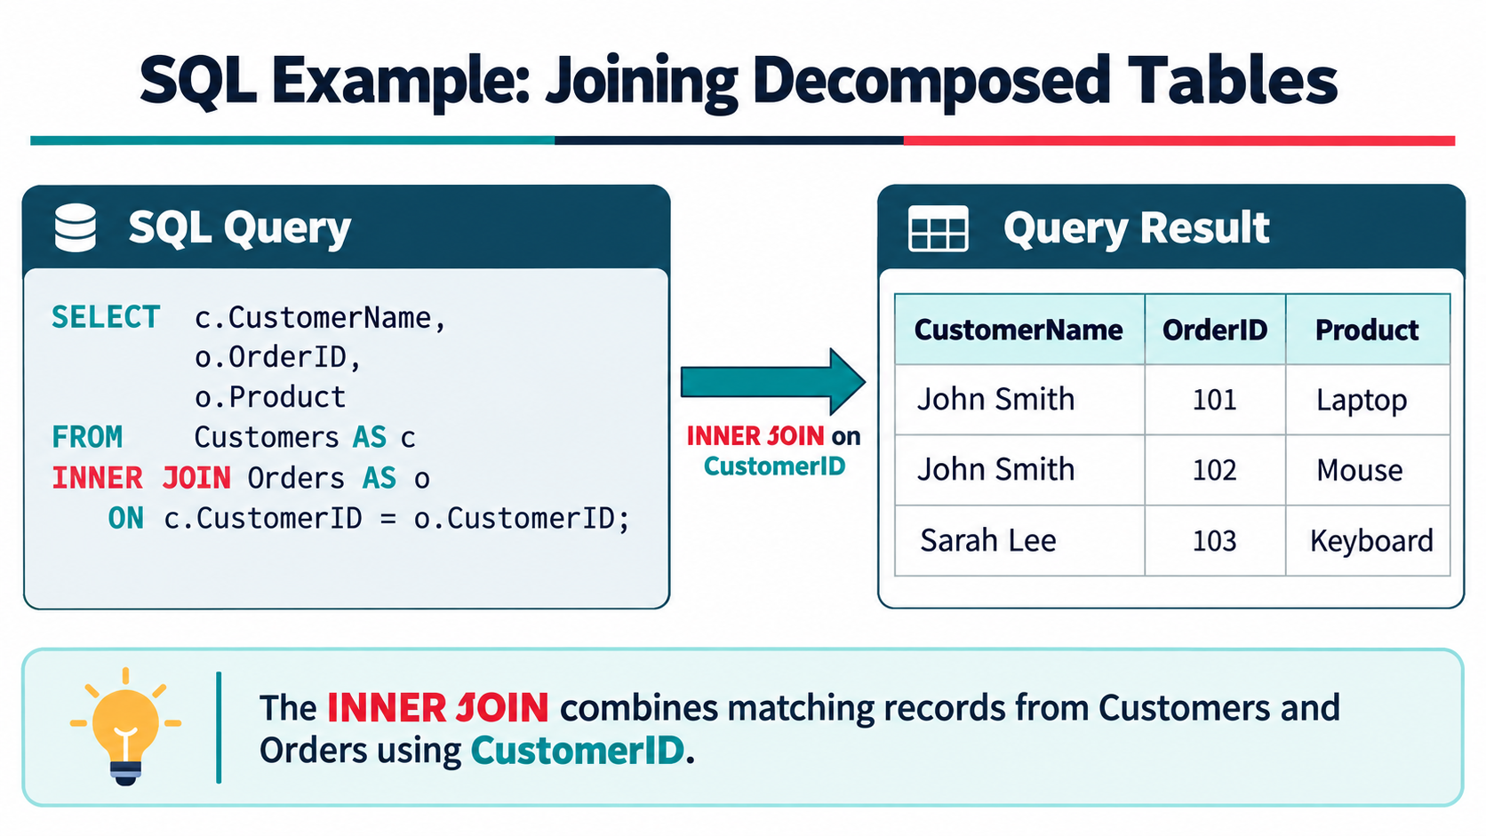
SQL Example: Joining Decomposed Tables
Decomposed data is stored in separate tables.
SQL JOIN combines related data.
INNER JOIN returns matching records only.
Primary and foreign keys connect the tables.
A lossless join reconstructs the original data.
Notes:
After decomposing a database, we can use SQL JOIN operations to bring related information back together.
This example uses an INNER JOIN between the Customers and Orders tables.
The query matches the CustomerID values in both tables and returns the related records.
For example, if John Smith has multiple orders, his name can appear next to each order in the query results.
However, his personal information only needs to be stored once in the Customers table.
This demonstrates how SQL JOINs allow us to retrieve related information without unnecessarily duplicating it in the database.

Slide 9
Advantages and Disadvantages of Database Decomposition
Advantages
Reduced Redundancy
Improved Data Integrity
Fewer Data Anomalies
Easier Maintenance
Better Data Organization
Disadvantages
Additional SQL JOINs
More Complex Queries
Possible Information Loss
Additional Design Planning
Potential Performance Tradeoffs
Notes:
Database decomposition has advantages, but it also introduces some challenges.
The biggest advantages include reducing duplicated information, improving data integrity, and making the database easier to maintain.
It also helps prevent problems when information is inserted, updated, or deleted.
However, separating information into multiple tables can make some SQL queries more complicated.
For example, we might need additional JOIN operations to retrieve information that was previously stored in one table.
Decomposition also requires careful planning because an incorrect design could cause information loss.
The goal is to improve the database structure while preserving the information and relationships we need.

Slide 10
What Is Polyglot Persistence?
Polyglot persistence is the practice of using multiple database technologies within the same application or software system.
Instead of relying on one database for everything, developers select databases based on specific data requirements.
Different database systems are optimized for different workloads and data structures.
Relational databases, document databases, and key-value stores can operate together.
Polyglot persistence is commonly associated with microservices and distributed applications.
Notes:
Now that we've discussed database decomposition, I'm going to move on to polyglot persistence.
Polyglot persistence means using more than one type of database technology within the same application or software system.
Instead of using one database for every kind of information, developers can choose different database technologies depending on what the application needs.
For example, one database might handle customer transactions, while another manages product information.
The idea is that different database systems have different strengths, so using them together can provide more flexibility.

Slide 11
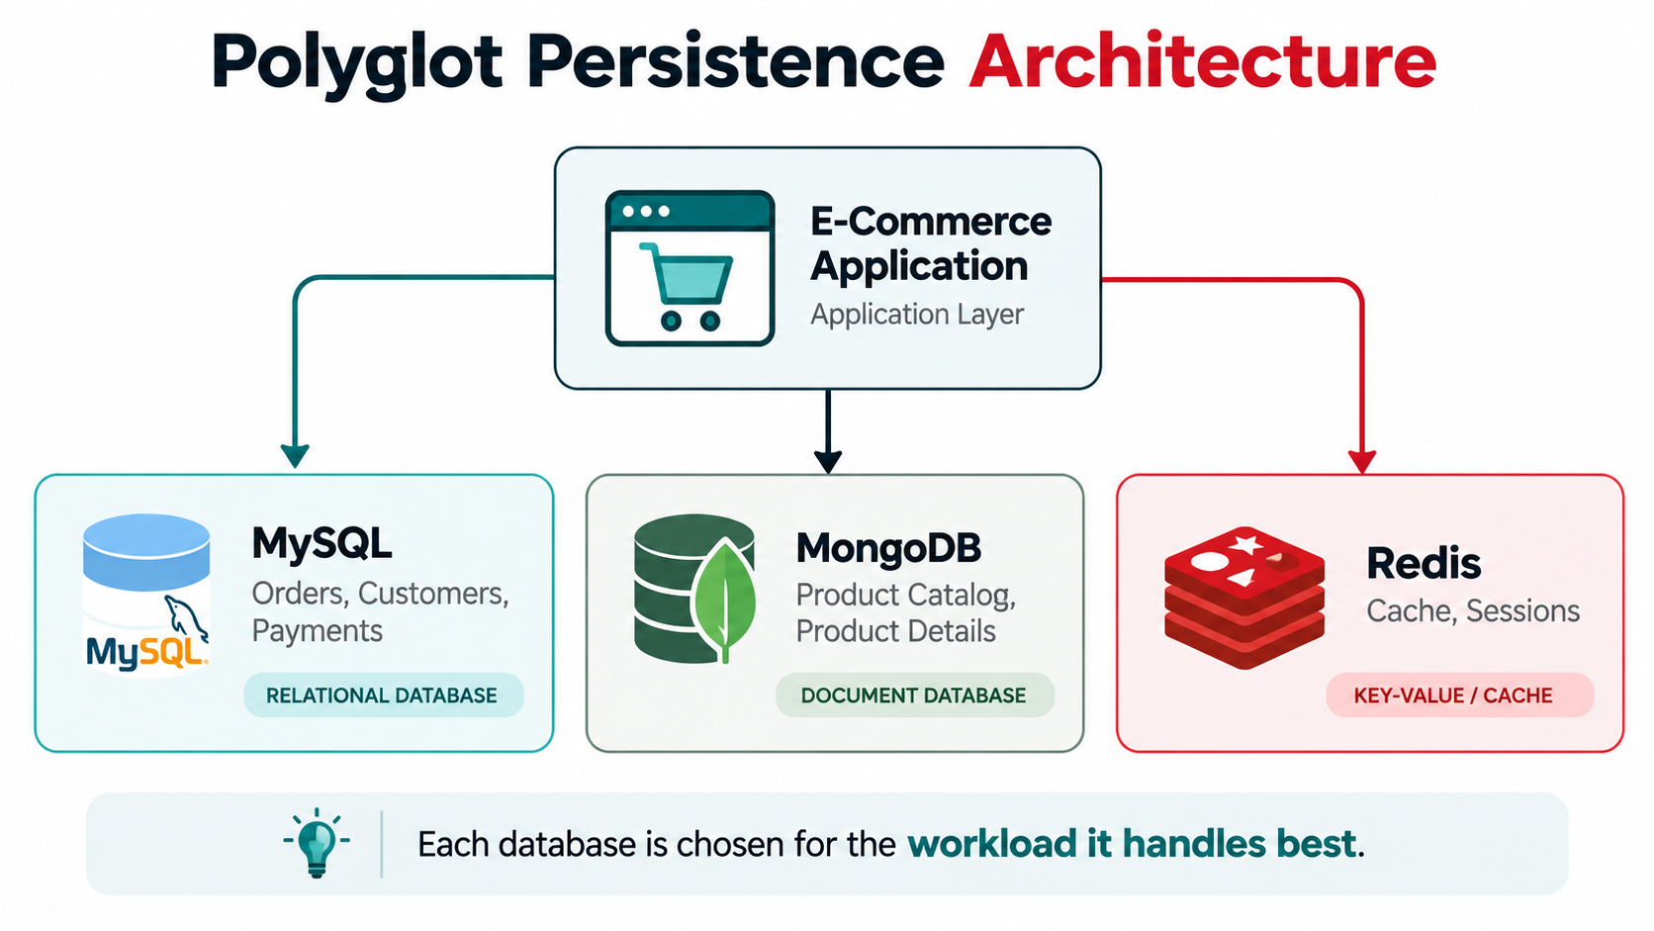
Polyglot Persistence Architecture
Polyglot persistence uses multiple database technologies.
MySQL: Manages customers, orders, and transactions.
MongoDB: Stores flexible product information.
Redis: Caches frequently accessed data.
Each database serves a different application requirement.
Services and APIs help coordinate information.
Notes:
his slide shows an example of how polyglot persistence can work in an online shopping application.
In this example, MySQL manages structured information such as customers, orders, and transactions.
MongoDB stores product information. This is useful because different products may have different attributes.
Redis is used to cache frequently requested information so the application can access it quickly.
The databases work together through the application's services and APIs.
The main idea is choosing the appropriate database technology for each part of the application rather than expecting one database to handle everything.

Slide 12

Why Do We Use Polyglot Persistence?
Performance: Choose database technologies suited to particular workloads.
Scalability: Scale individual data services according to demand.
Flexibility: Support structured, semi-structured, and unstructured data.
Specialization: Use databases designed for specific operations, such as caching or full-text search.
Application Needs: Allow different services to manage their data independently.
Example: An e-commerce application can use MySQL for orders, MongoDB for product catalogs, and Redis for caching.
Notes:
There are several reasons developers might use polyglot persistence.
One reason is performance. Different databases are designed to handle different workloads.
Another reason is flexibility. A relational database is useful for structured information, while a document database can handle records with different attributes.
Polyglot persistence can also help with scalability because different parts of an application may need to grow independently.
However, developers should only introduce multiple databases when there is a good reason to do so.
Using additional databases also means having more systems to maintain.

Slide 13
Types of Databases: SQL vs. NoSQL
Feature | SQL Databases | NoSQL Databases
Data Structure | Relational tables | Documents, key-value, graph, etc.
Schema | Typically predefined | Often more flexible
Relationships | Primary and foreign keys | Depends on database type
Query Language | Usually SQL | Varies by technology
Examples | MySQL, PostgreSQL | MongoDB, Redis
Common Uses | Orders, financial records | Catalogs, caching, flexible data
SQL vs. NoSQL Databases
Key Point: Neither category is automatically better. The appropriate database depends on application requirements.
Notes:
This slide compares SQL and NoSQL databases.
SQL databases organize information into relational tables. They generally use predefined schemas and support relationships through primary keys and foreign keys.
Examples include MySQL and PostgreSQL.
NoSQL is a broader category that includes document, key-value, graph, and other database models.
Some NoSQL databases allow more flexibility in how information is structured.
For example, a document database might store a laptop with RAM and storage information, while a mouse document contains wireless and DPI information.
Neither SQL nor NoSQL is automatically better. The right choice depends on the data and the application's requirements.

Slide 14
Real-World Example of Polyglot Persistence
An online shopping application handles several different types of information.
MySQL — Relational Database
Stores customer accounts, orders, and payment records.
Supports structured relationships and transactional consistency.
MongoDB — Document Database
Stores product catalogs with varying attributes.
Supports flexible product descriptions and document structures.
Redis — Key-Value Database
Caches frequently requested information.
Supports fast access to session data and temporary information.
Result: Each database supports a different part of the application based on its strengths.
Notes:
Let's look at how polyglot persistence could work in an online store.
An online store needs to manage different types of information.
MySQL could store customers and orders because those records have structured relationships.
MongoDB could manage the product catalog because products may have different attributes.
Redis could cache frequently requested information so the application doesn't need to retrieve it from the primary database every time.
By using these different technologies together, developers can design each part of the application around its data requirements.
However, the application still needs a way to coordinate information across those systems.

Slide 15
Advantages and Disadvantages of Polyglot Persistence
Advantages
Better Performance
Flexible Data Storage
Independent Scaling
Specialized Databases
Improved Flexibility
Disadvantages
Increased Complexity
Higher Maintenance Costs
Difficult Data Synchronization
Cross-Database Queries
Additional Security Needs
Notes:
One of the biggest challenges with polyglot persistence is data consistency.
When information is stored across different database systems, changes might need to be shared between them.
For example, imagine that a product's price changes in MongoDB, but Redis still contains the old cached price.
If the application continues using the cached information, customers might see an outdated price.
Developers can address situations like this using cache invalidation, event-driven communication, and synchronization techniques.
These approaches help keep information reliable, but they also require careful planning.
This is why using multiple databases introduces additional responsibilities.

Slide 16
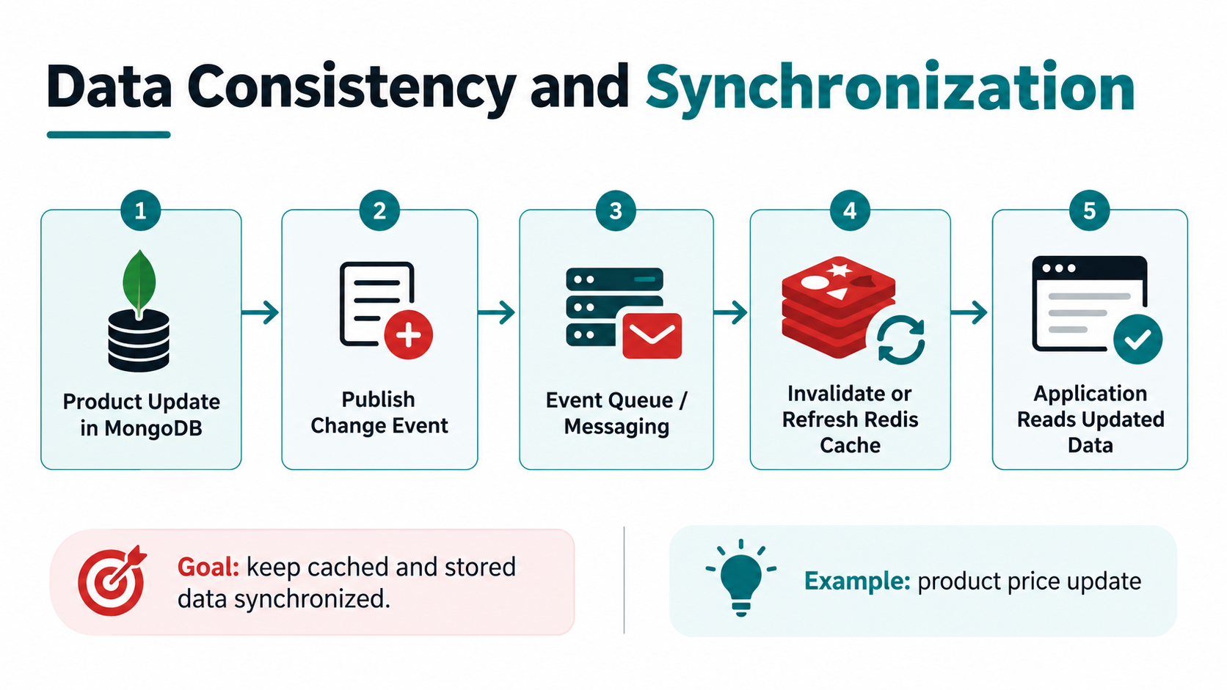
Data Consistency and Synchronization
Using multiple databases can make it more difficult to keep related information consistent.
Data synchronization ensures that changes are shared between systems when necessary.
Eventual Consistency: Some updates may take time to appear across all databases.
Cache Invalidation: Cached information must be updated or removed when the original data changes.
Event-Driven Architecture: Applications can publish events that notify other services about important changes.
Developers may use message queues, retries, and monitoring to improve reliability.
Notes:
One of the biggest challenges with polyglot persistence is data consistency.
When information is stored across different database systems, changes might need to be shared between them.
For example, imagine that a product's price changes in MongoDB, but Redis still contains the old cached price.
If the application continues using the cached information, customers might see an outdated price.
Developers can address situations like this using cache invalidation, event-driven communication, and synchronization techniques.
These approaches help keep information reliable, but they also require careful planning.
This is why using multiple databases introduces additional responsibilities.

Slide 17
How the Two Concepts Work Together
Database Decomposition
Polyglot Persistence
Working Together
Divides relational data into smaller tables.
Reduces duplicate information.
Improves data integrity.
Focuses on organizing data.
Uses multiple database technologies.
Supports different data requirements.
Improves flexibility and scalability.
Focuses on selecting databases.
MySQL: Stores normalized customer and order data.
MongoDB: Stores flexible product information.
Redis: Caches frequently accessed data.
Notes:
Database decomposition and polyglot persistence solve different problems, but they can work together.
Database decomposition focuses on organizing relational information into smaller, related tables.
Polyglot persistence focuses on using multiple database technologies based on the application's requirements.
For example, an online shopping application could use normalized MySQL tables for customer and order information.
It could also use MongoDB for flexible product information and Redis for caching.
This means developers can improve the organization of relational data while also choosing different database technologies for other workloads.
Both approaches can contribute to reliable and maintainable applications.

Slide 18
Importance in Modern Software Development
Database design influences application performance, reliability, scalability, and long-term maintenance.
Decomposition helps developers build consistent relational data models and prevent data anomalies.
Polyglot persistence allows software architectures to support different data requirements efficiently.
Both concepts are important in enterprise applications, cloud computing, and microservices architecture.
Understanding these approaches helps developers make informed decisions about storing and managing application data.
Example: A large online retailer may need strong transaction management, flexible catalog storage, and fast caching within one application.
Notes:
These concepts are important because database design directly affects software development.
Developers need to think about how information will be organized, retrieved, updated, and maintained.
Poor database design can create problems that become more difficult to fix as an application grows.
Database decomposition helps developers organize relational information and maintain consistent relationships.
Polyglot persistence gives developers more options when different parts of an application have different data requirements.
Understanding both approaches helps developers make better decisions when designing software systems.

Slide 19
Future Trends in Database Management
Cloud-Managed Databases: Cloud platforms simplify database deployment, backups, and infrastructure management.
Distributed Database Systems: Applications increasingly distribute data across servers and geographic locations.
Specialized Database Technologies: Developers can select database systems designed for specific workloads.
Automation and Monitoring: Automated tools help identify performance issues and support database maintenance.
Data Integration: Applications require reliable ways to share information across different databases.
Hybrid Architectures: Organizations may combine relational, NoSQL, cloud, and on-premises database systems.
Notes:
Database technology continues to change as software applications become more complex.
One important trend is cloud-managed databases. Services from cloud providers can handle tasks such as infrastructure management, backups, and monitoring.
Distributed databases are also important because applications may need to manage information across different locations.
Developers are also using more specialized databases for different workloads.
Because of these developments, understanding both relational database design and different types of database technologies will continue to be useful.
I think these concepts are especially important for developers working with cloud applications and modern software architectures.

Slide 20
When Should Developers Use Each Approach
Use Database Decomposition When:
Consider Polyglot Persistence When:
When Is One Database Enough?
A relational database contains unnecessary duplicate information.
Insertions, updates, or deletions create data anomalies.
Data integrity and well-defined relationships are important.
A database needs a more maintainable relational structure.
Different workloads have substantially different storage requirements.
Specialized database systems offer meaningful performance or functionality benefits.
Independent application services require different data models.
The benefits of multiple databases justify the operational complexity.
A single relational database meets the application's performance and data requirements.
Simplicity, centralized management, and strong transactional consistency are priorities.
Notes:
One important question is when developers should use database decomposition or polyglot persistence.
Database decomposition is useful when a relational database contains duplicated information or when its structure causes data inconsistencies.
Polyglot persistence is worth considering when different parts of an application have significantly different storage requirements.
However, using multiple databases isn't always necessary.
If one relational database can handle the application's requirements efficiently, keeping the system simpler may be the better decision.
The main lesson is that developers should choose database approaches based on actual needs rather than using a technology simply because it's popular.

Slide 21
Conclusion and Key Takeaways
Database decomposition reduces redundancy and improves data integrity.
Polyglot persistence uses different database technologies based on application needs.
Both approaches support reliable and maintainable software systems.
Developers must consider performance, complexity, and data consistency.
Choosing the right database strategy depends on application requirements.
What I Learned
Researching these topics helped me better understand how database organization and technology choices affect software development. I learned that both approaches solve different problems but can work together to support modern applications.
Notes:
To conclude, database decomposition and polyglot persistence are two important approaches used in software development.
Database decomposition helps organize relational information into smaller tables, reducing duplication and improving data integrity.
Polyglot persistence allows developers to use different database technologies for different types of information.
One thing I learned while researching these topics is that there isn't one database design or technology that is best for every situation.
Developers need to consider performance, scalability, consistency, and maintenance when deciding how to manage data.
Overall, researching these topics helped me understand how database design decisions affect software applications and why those decisions are important.
Thank you for listening to my presentation.

Slide 22

References
Fowler, M. (2011, November 16). Polyglot persistence. https://martinfowler.com/bliki/PolyglotPersistence.html
Microsoft. (n.d.). Description of the database normalization basics. Microsoft Learn. https://learn.microsoft.com/en-us/troubleshoot/microsoft-365-apps/access/database-normalization-description
Microsoft. (n.d.). Data considerations for microservices. Microsoft Learn. https://learn.microsoft.com/en-us/azure/architecture/microservices/design/data-considerations
MongoDB. (n.d.). Data modeling concepts with MongoDB. https://www.mongodb.com/resources/basics/databases/data-modeling
Oracle. (n.d.). MySQL glossary. MySQL 8.4 Reference Manual. https://dev.mysql.com/doc/refman/8.4/en/glossary.html
Redis. (n.d.). Redis use cases. https://redis.io/docs/latest/develop/use-cases/
Notes:
These are the references I used while researching my presentation.
I used Microsoft documentation to better understand database normalization and data management.
I also used Martin Fowler's explanation of polyglot persistence and documentation from MySQL, MongoDB, and Redis.
These resources helped me understand how the concepts work and why developers use them.
That concludes the presentation portion. Next, I'll guide everyone through the technical activity using Azure SQL Database and Azure Cosmos DB for NoSQL.

